Slide 1
Hybrid Quantum Neural Networks for Remote Sensing Imagery Classification
QCML
Project presentation
VADHRI VENKATA RATNAM
July 2023

Slide 2
Inside
Remote sensing image classification
Datasets
Classical CNN
Quantum hybrid CNN
Submission & References

Slide 3
Remote sensing image classification
Images captured through satellite and drones are used to observe surface of the Earth.
Use-cases
Improving Agriculture
Studying Urban Geography
Managing Disaster Recovery
Solar Panel Energy Output Optimization
Monitoring drought and weather patterns
Land use and land cover analysis
Civil engineering study
Saving Wildlife

Slide 4
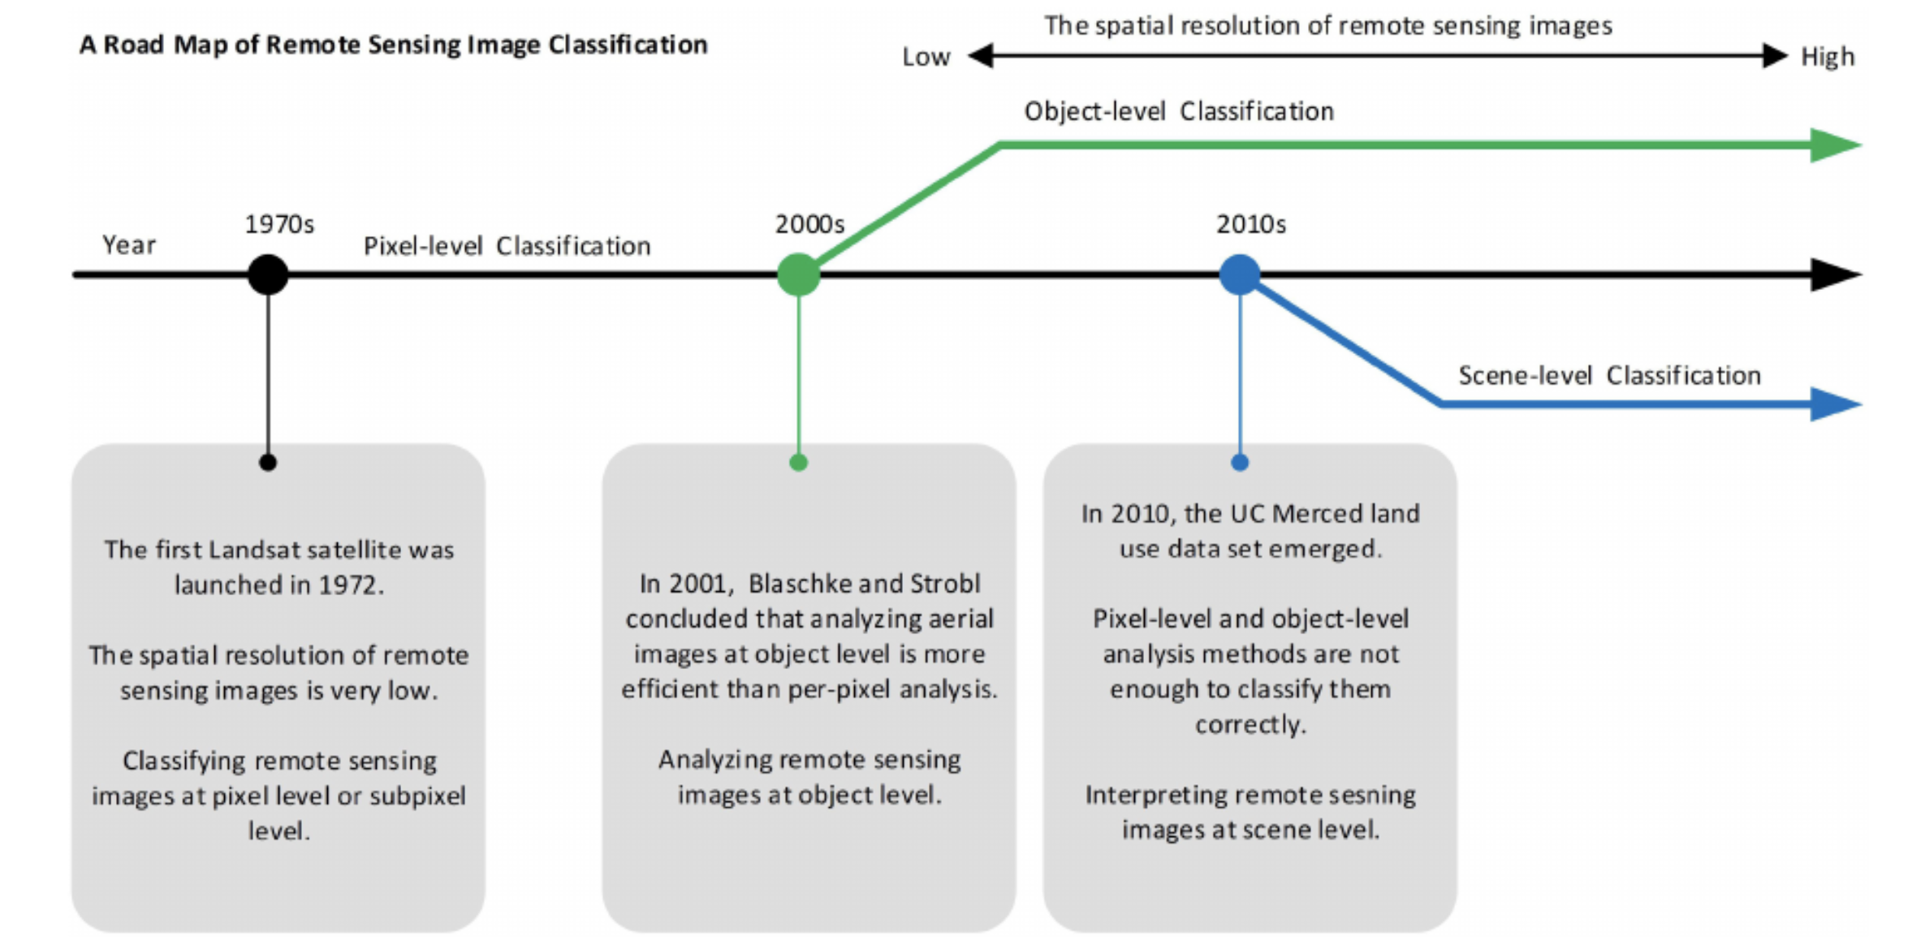
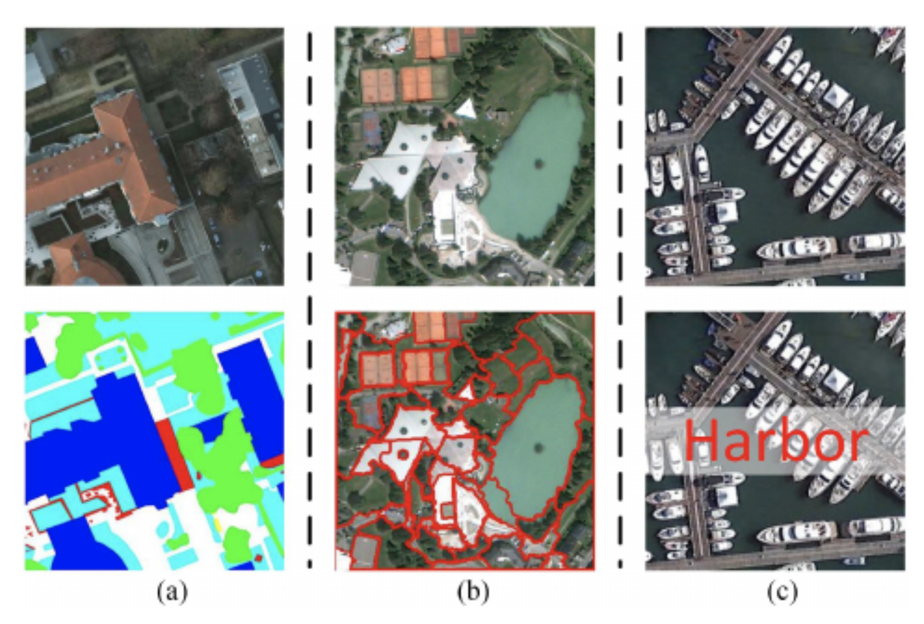
Remote sensing image classification (contd)

Slide 5
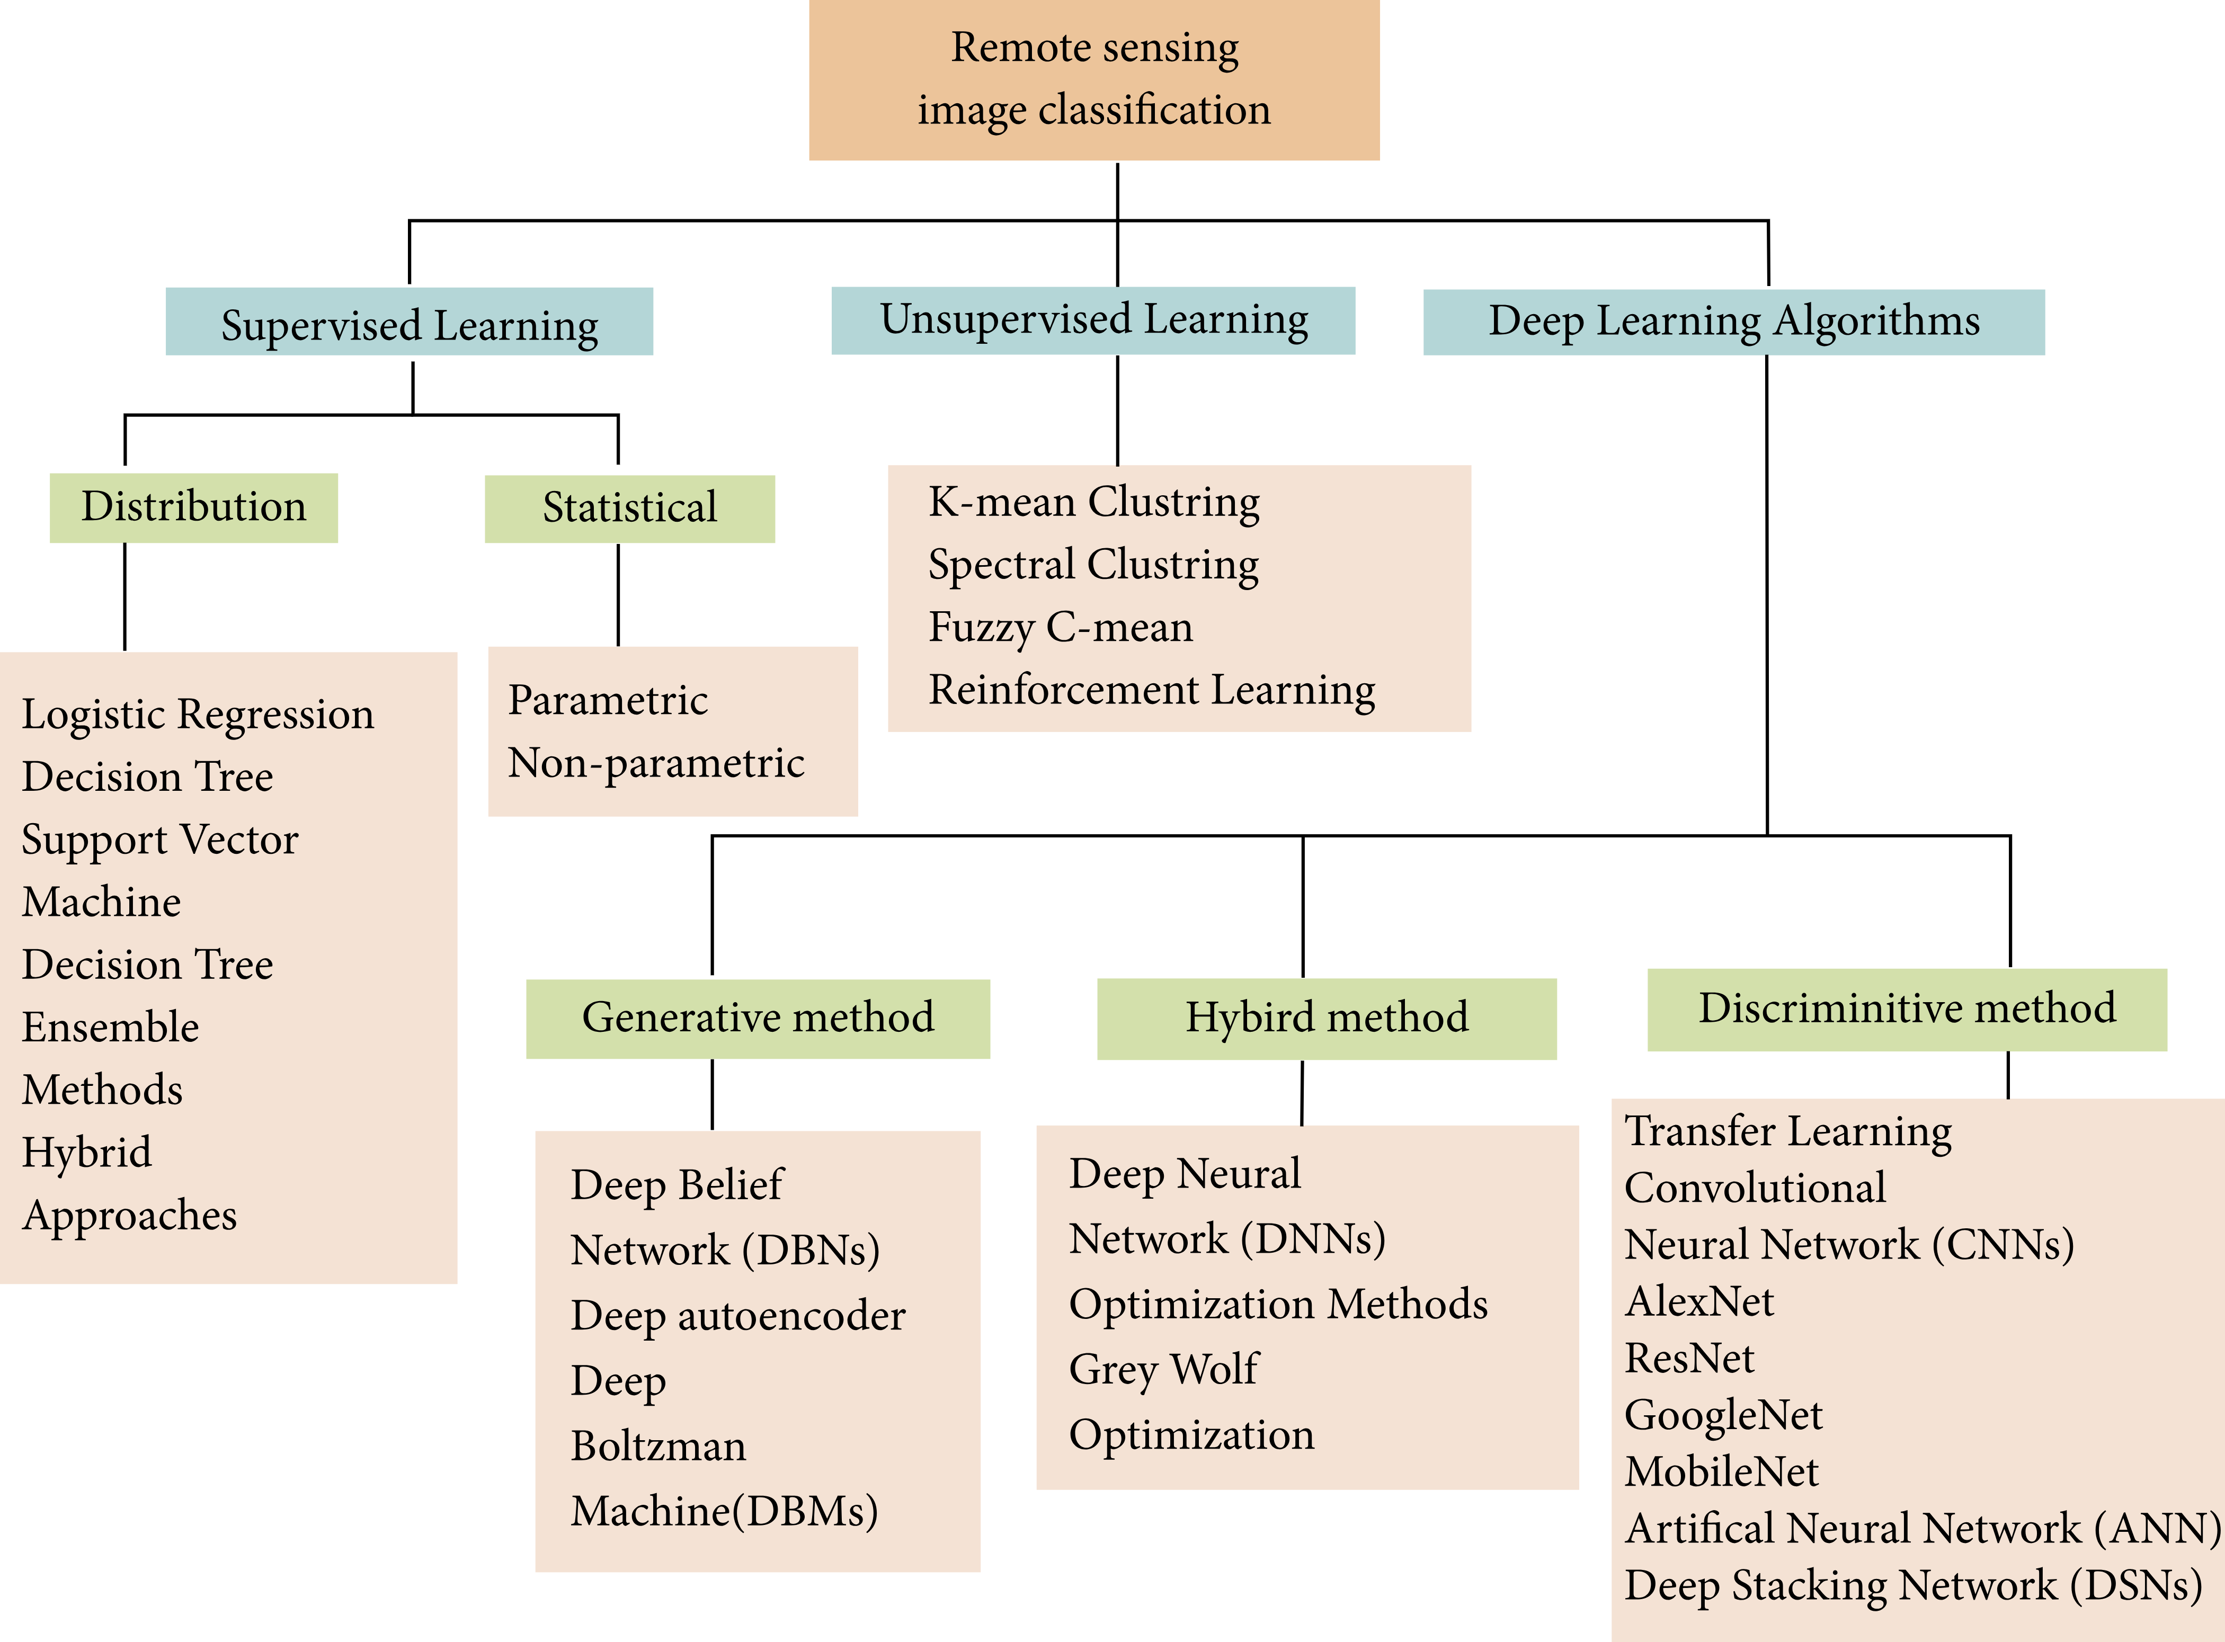
Remote sensing image classification (contd)

Slide 6
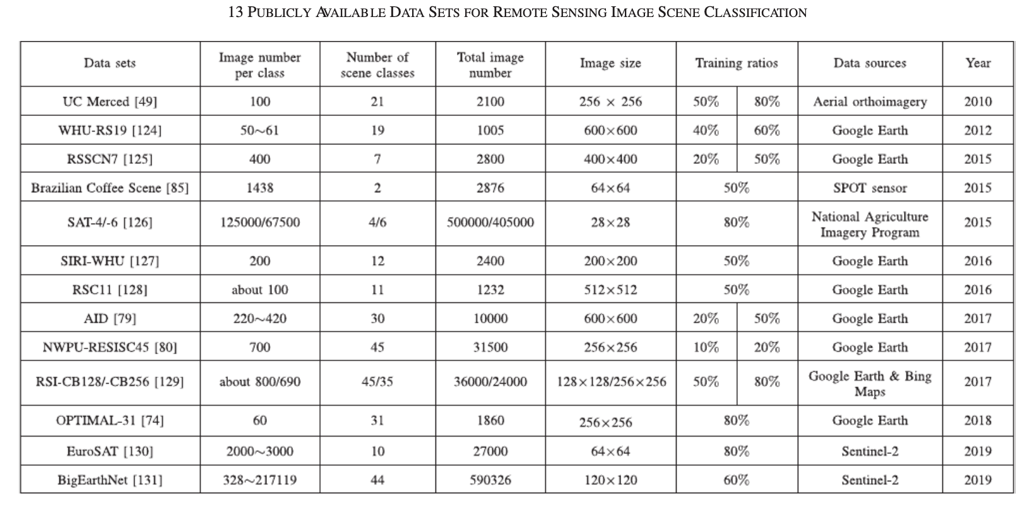
Dataset
Ref. [4]

Slide 7
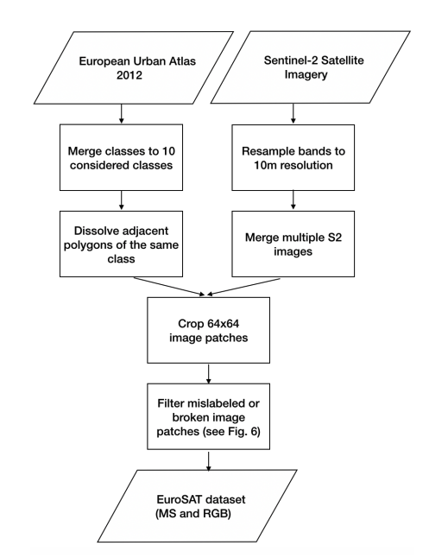
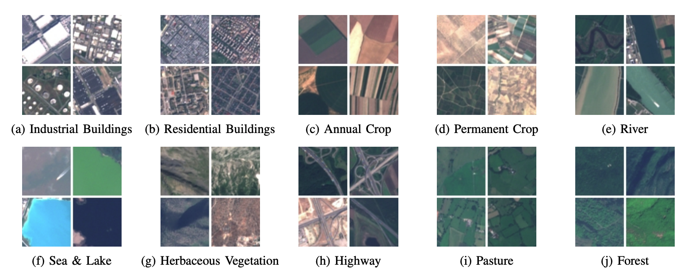
Dataset (contd)
Sentinel-2A is one satellite in the two-satellite constellation of the identical land monitoring satellites Sentinel-2A and Sentinel-2B.
Source of the dataset is mutli-spectral image data provided by the Sentinel-2A satellite.
The Sentinel-2 satellite constellation provides about 1.6 TB of compressed images per day
Based on the obtained satellite images, a dataset of 27,000 georeferenced and labeled image patches is created.
The image patches measure 64x64 pixels and have been manually checked.
Ref. [4]
EuroSAT dataset creation process.

Slide 8
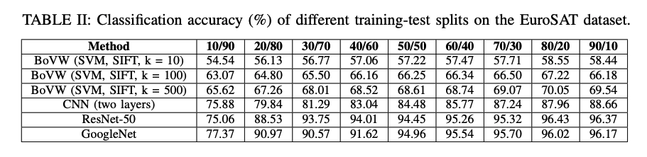
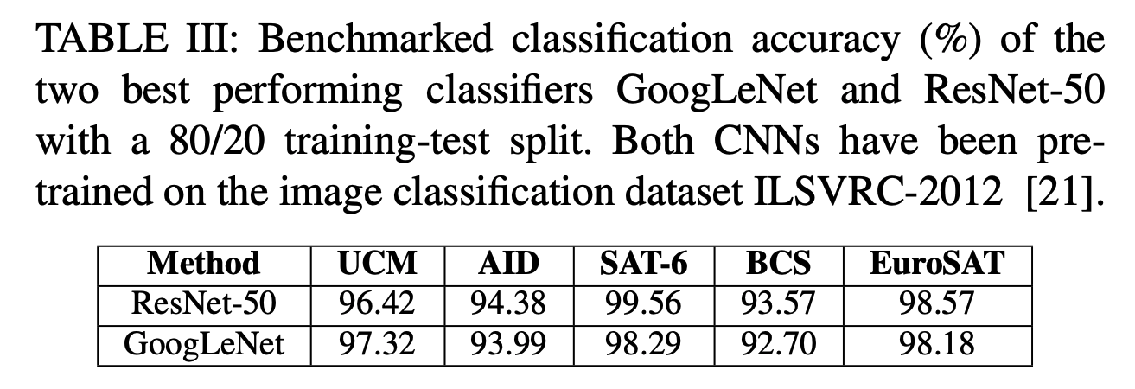
Dataset (contd)
Ref. [4]

Slide 9
Sample NN model training loop
Refresher
Ref [14]

Slide 10
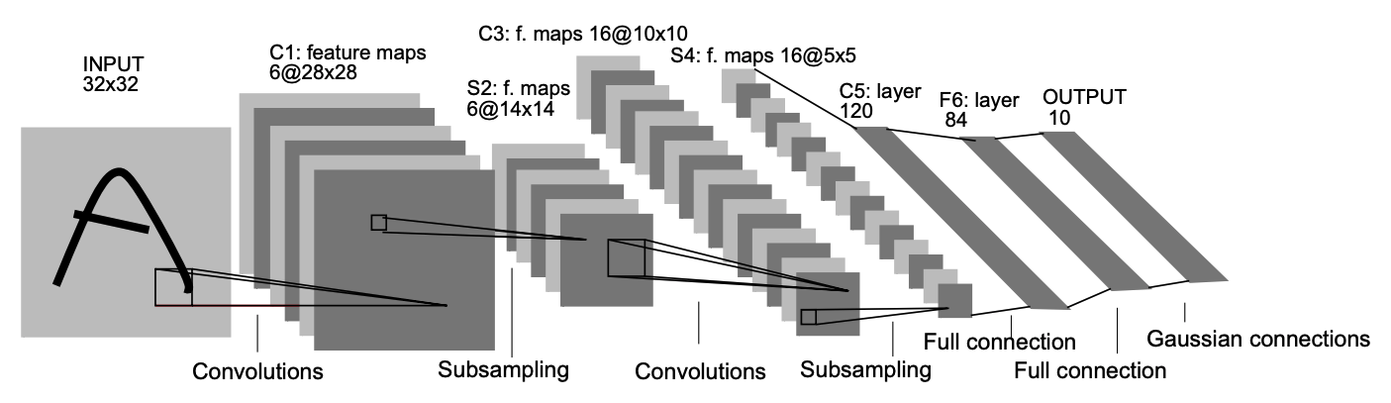
Classical CNN
Architecture of Lenet-5
Ref [5]

Slide 11
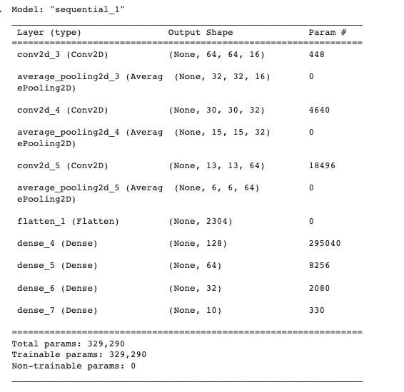
Classical CNN
EuroSAT - Modified LeNet-5 ( 27k images; multi-class (10) classification )
Eurosat_multi_class_classification_classical.ipynb

Slide 12
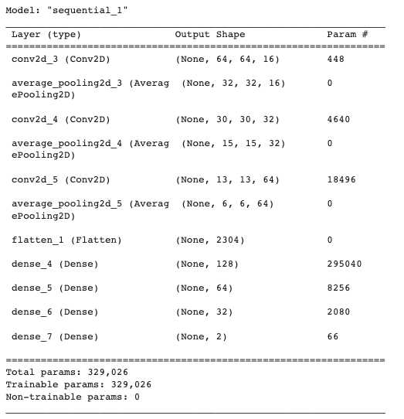
Classical CNN
EuroSAT - Modified LeNet-5 ( 5.5k images; binary classification )
Eurosat_binary_classification_classical.ipynb

Slide 13
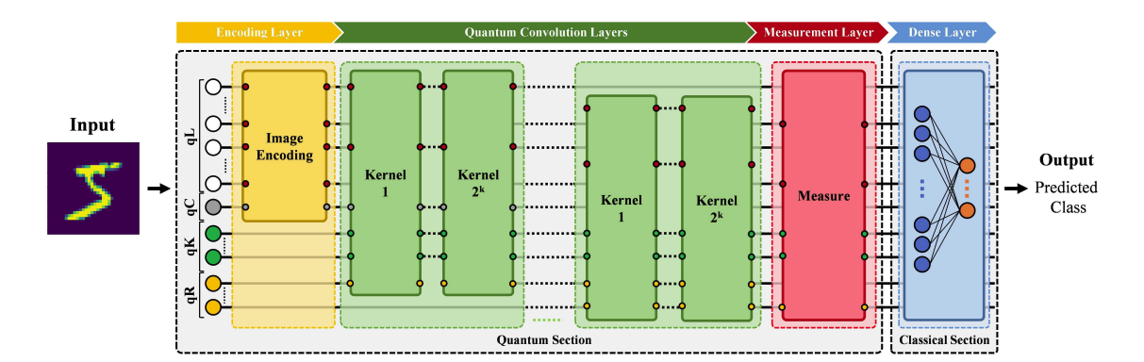
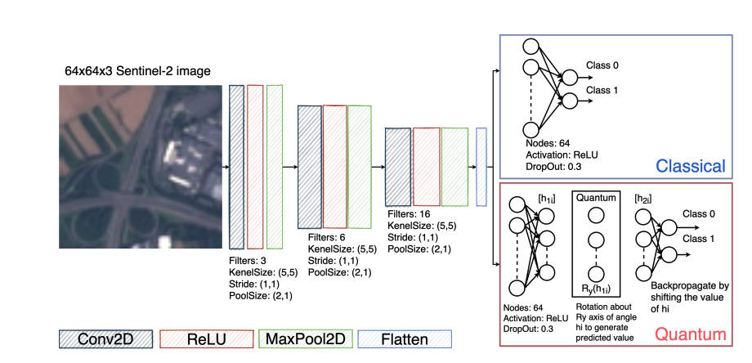
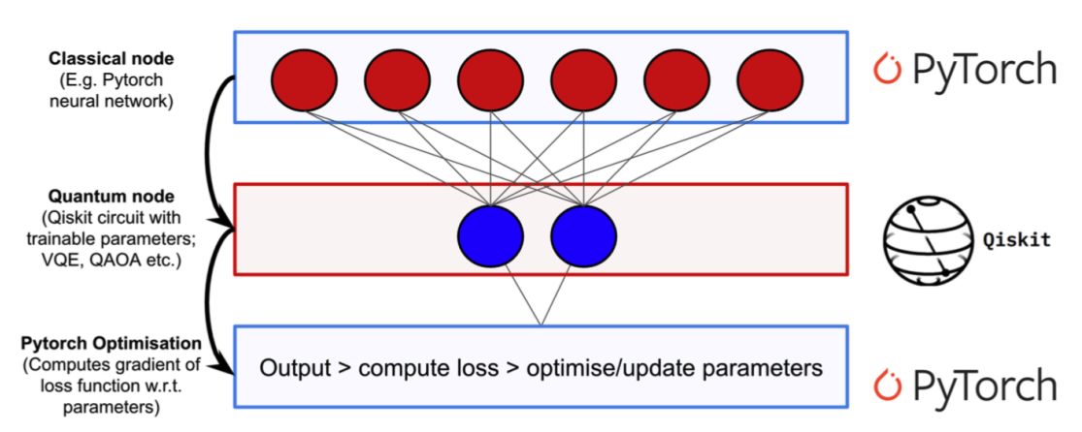
Quantum hybrid CNN
Problem statement
Some approaches
Accelerate feature extraction compared with its classical counterpart and handle multicategory classification tasks with reduced quantum resources
Introduce a hidden quantum layer into the quantum neural network to use the quantum circuit for refining the model.

Slide 14
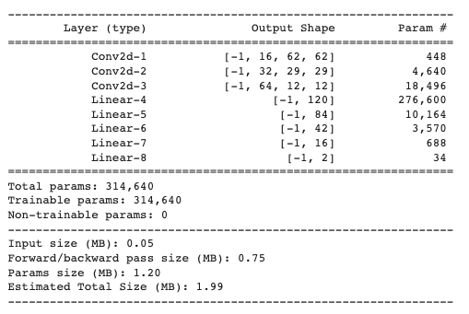
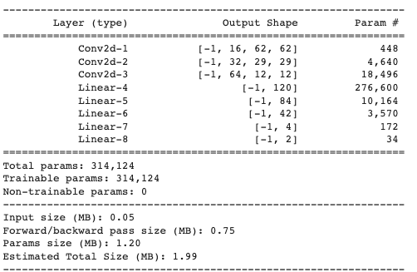
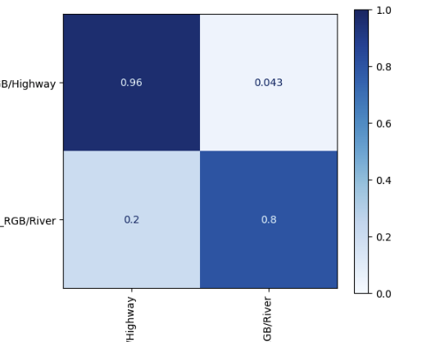
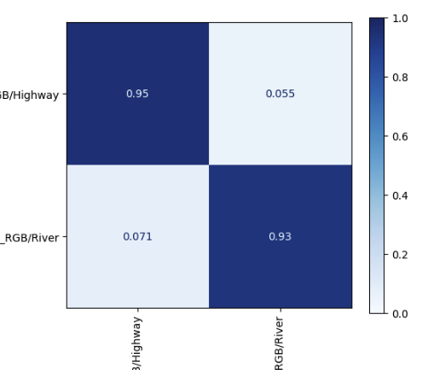
Hybrid binary classifier
Eurosat-hybrid-binary-classifier.ipynb
L (classical); R (hybrid)

Slide 15
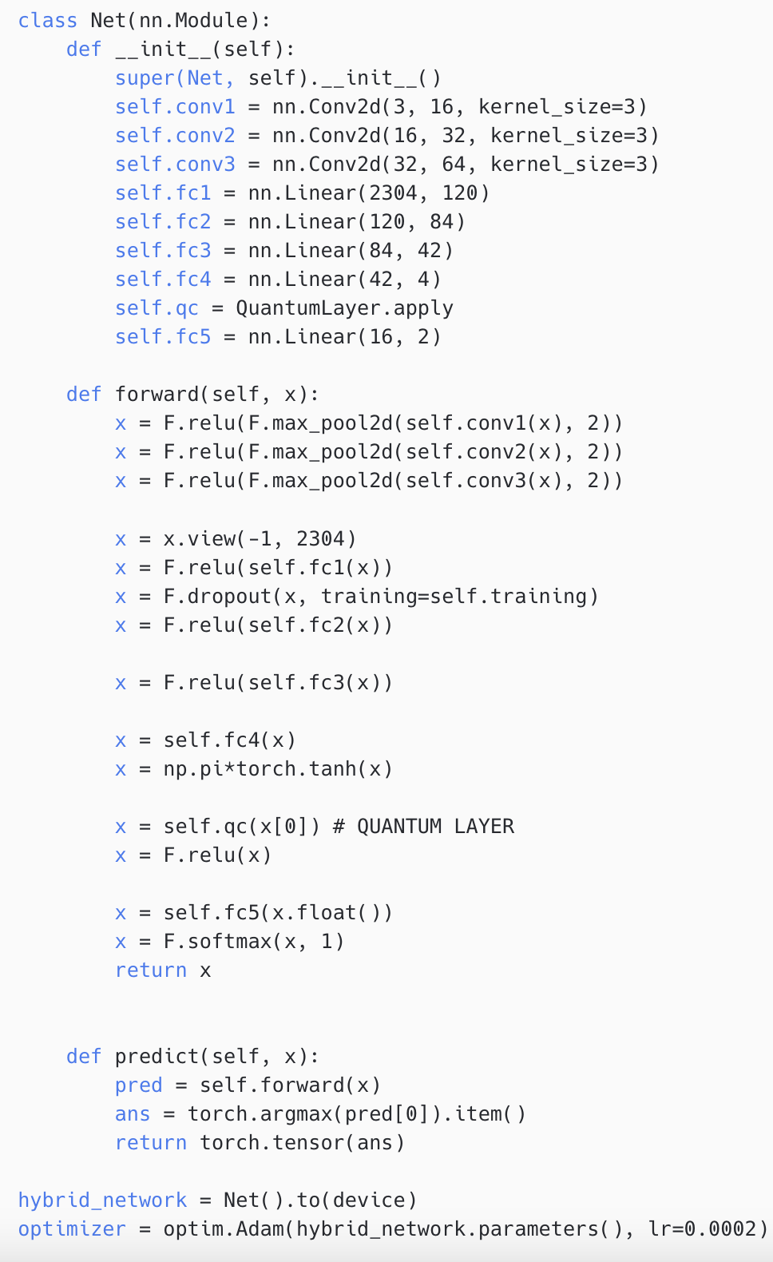
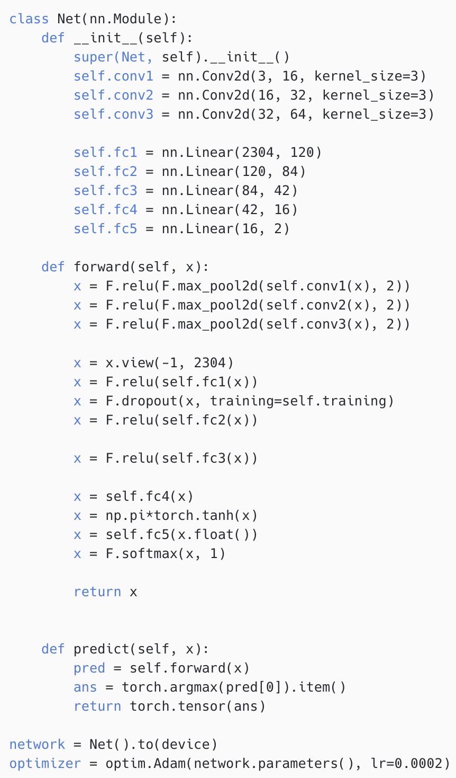
Hybrid binary classifier
L (classical); R (hybrid)
Eurosat-hybrid-binary-classifier.ipynb

Slide 16
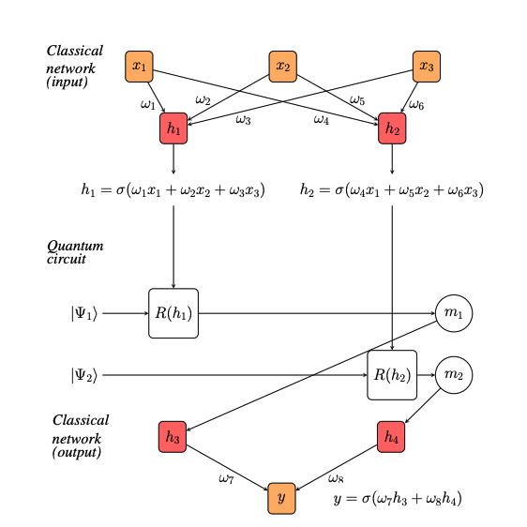
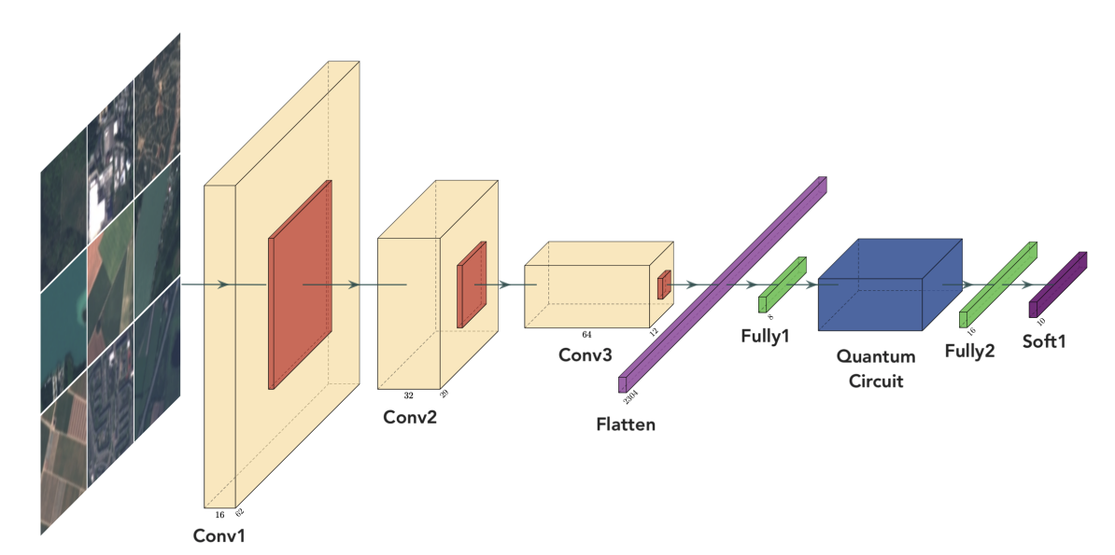
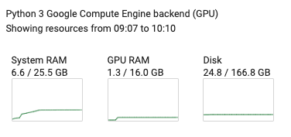
Hybrid CNN
Hidden layer
A parametrised quantum circuit is typically used as a hidden layer for the neural network.
Expressibility of the circuit plays a role in efficiency.
Higher dimensional quantum representation of classical data in the creation of the hybrid model
Inputs for the circuit are classically derived in the layer before, in the diagram, h1, h2
Embed quantum circuit into gradient calculation for optimisation.
Ref [1]

Slide 17
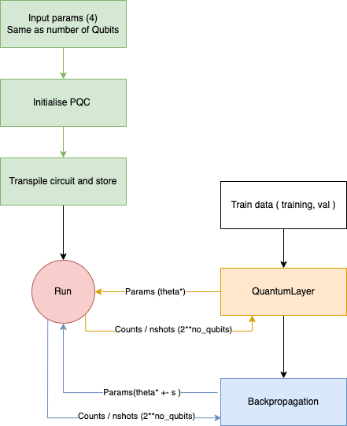
Hybrid CNN
Quantum circuits
Bellman
Input parameters : 4
Output states : 16
Real-amplitudes
Input parameters : 8
Output states : 16

Slide 18
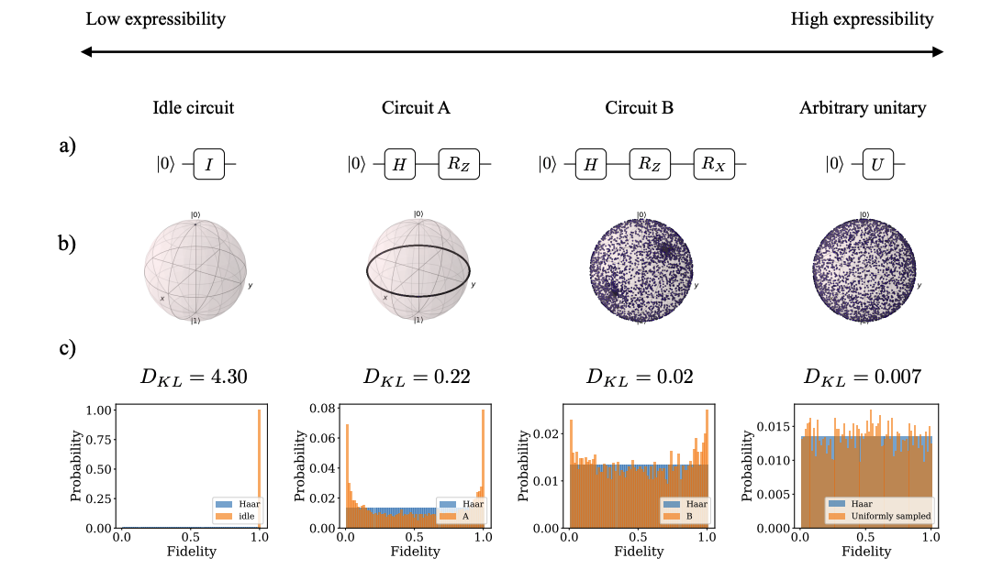
Hybrid CNN
Expressibility
Lower Kullback-Leibler (KL) divergence value corresponds to more favourable expressibility or a greater closeness to Haar random states.
KL 4.317
KL 0.215
KL 0.033
Expressibility.ipynb

Slide 19
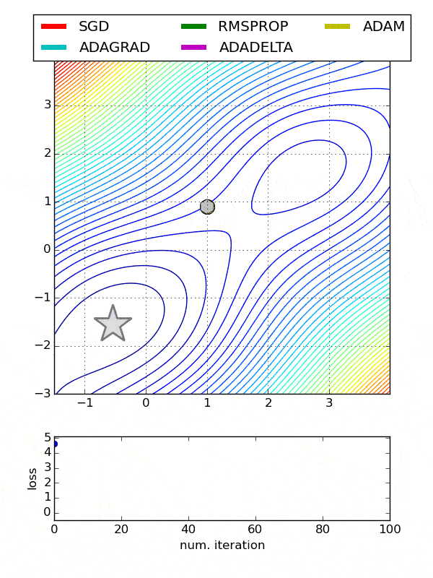
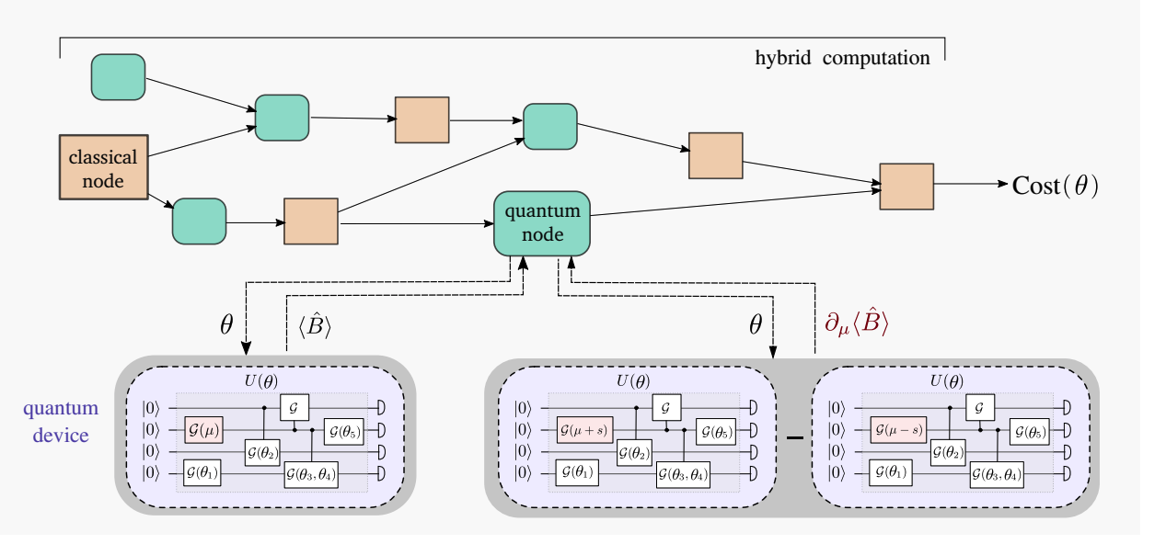
Hybrid CNN
Optimization, Parameter shift rule
The same circuit can be used to compute both the quantum function and the gradient of the quantum function
Chapter notes 16; S 4.1
Ref [11]

Slide 20
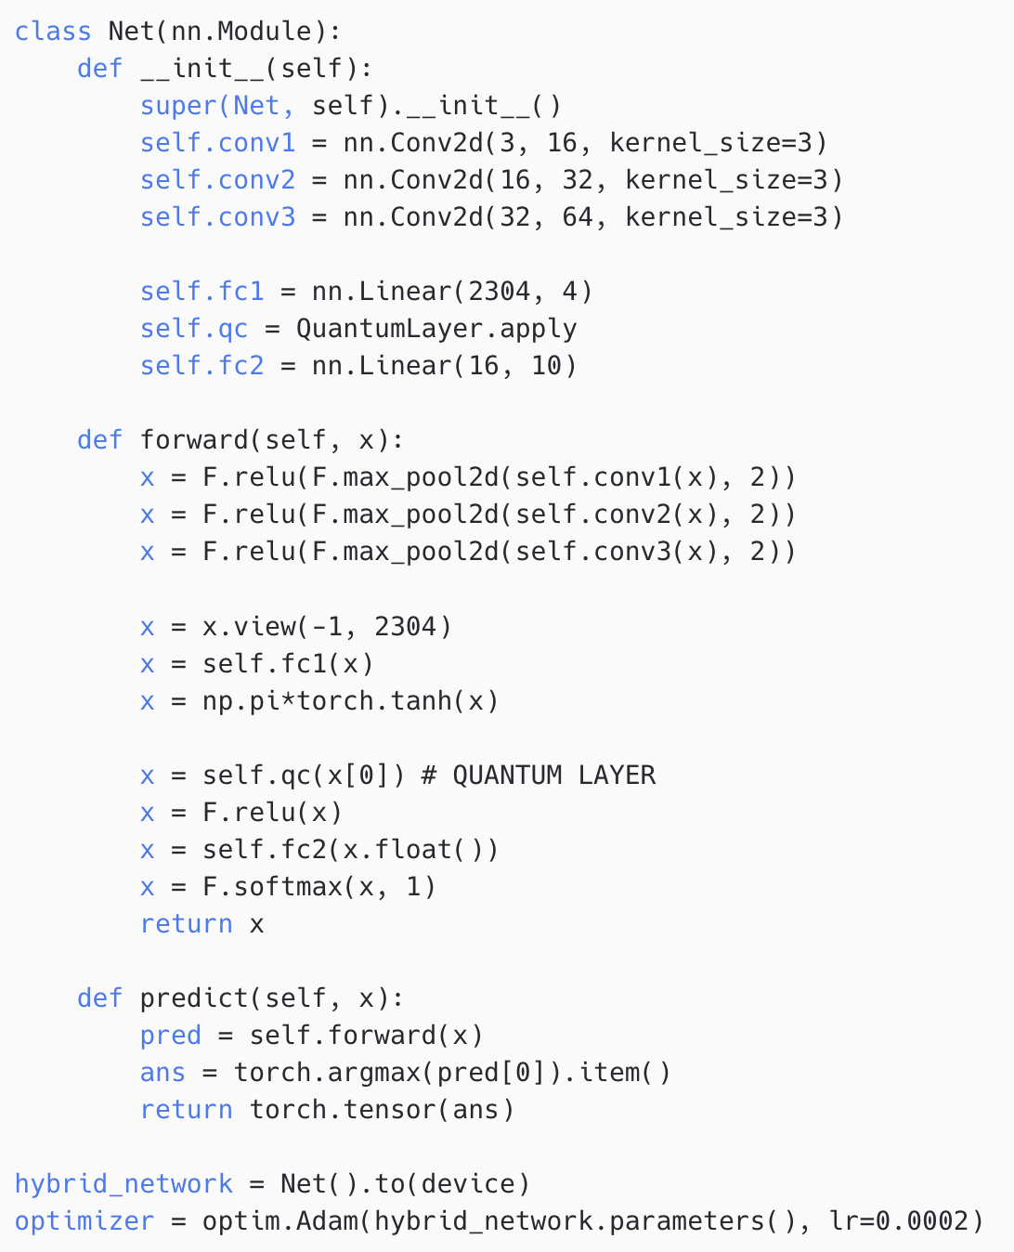
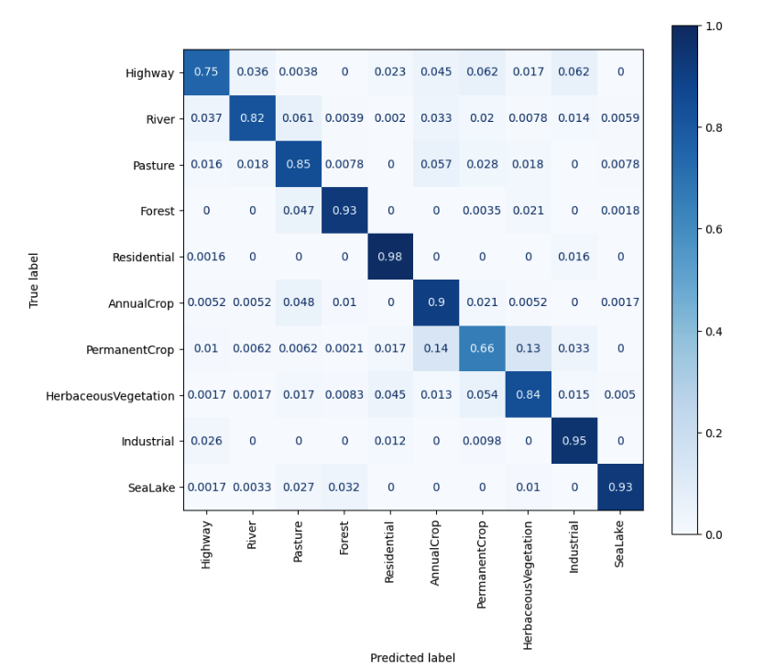
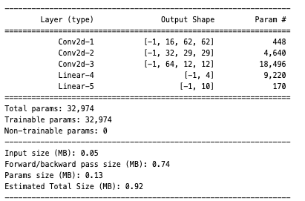
Hybrid CNN
Bell state - Classifier confusion matrix
Classical
Bellman
Eurosat_hybrid_multi_class_classifier_bell.ipynb

Slide 21
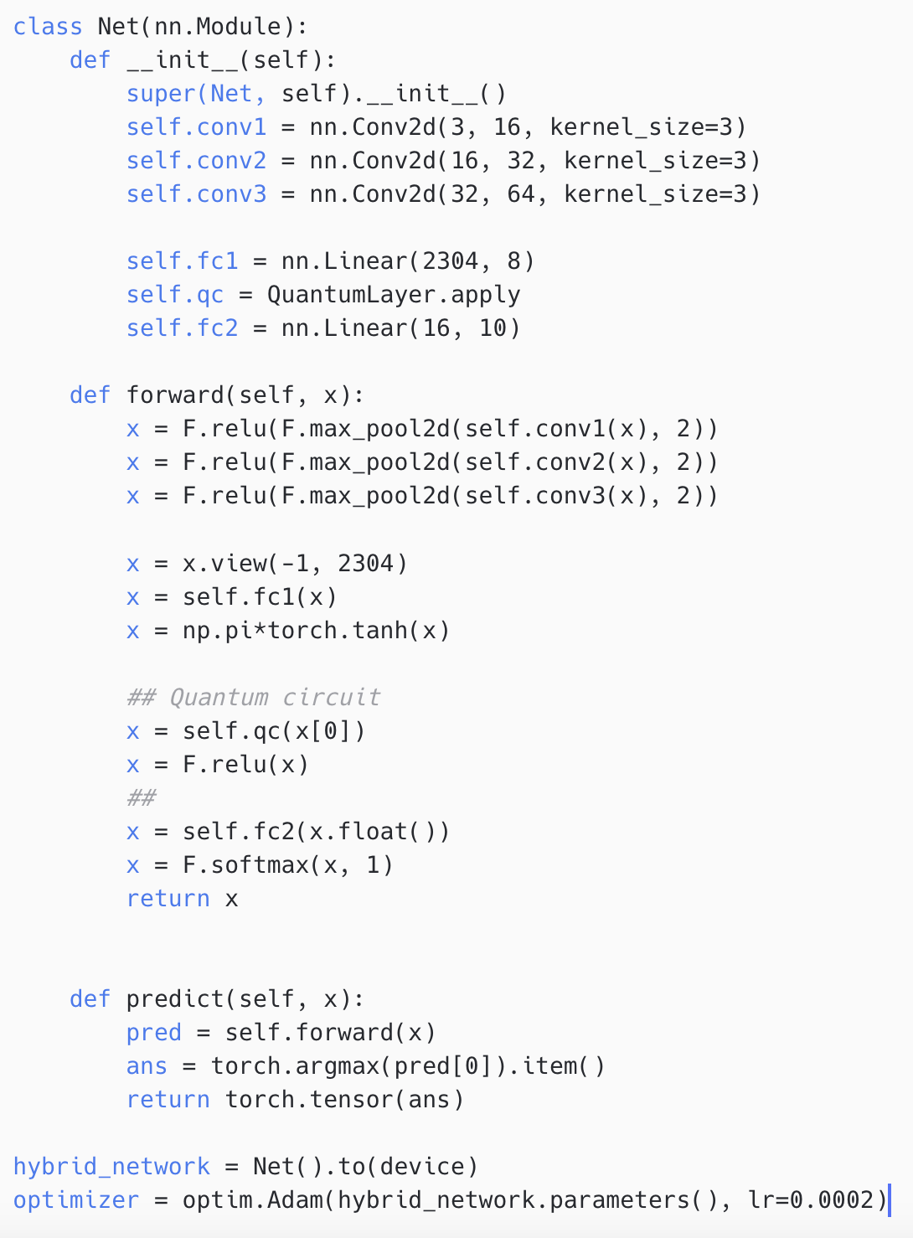
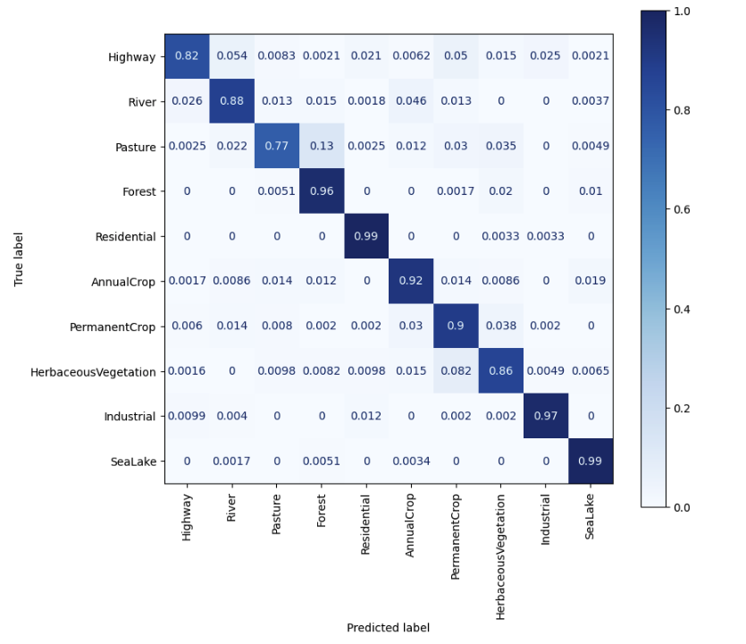
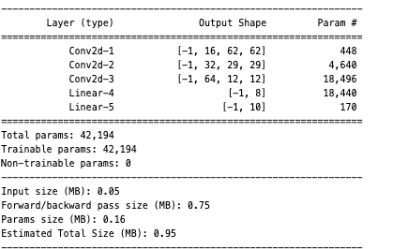
Hybrid CNN
Real Amplitude - Classifier confusion matrix
Bellman
RealAmplitude
Eurosat_hybrid_multi_class_classifier_real_amplitudes.ipynb

Slide 22
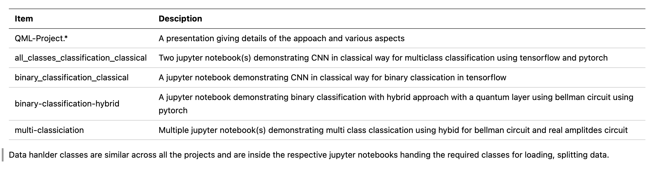
Submission
.
├── QML-project.*
├── README.md
├── all_classes_classification_classical
│ ├── CNN-all_classes.h5
│ └── Eurosat_multi_class_classification_classical.ipynb
├── binary-classification-hybrid
│ ├── Eurosat_hybrid_binary_classifier.ipynb
│ ├── Eurosat_hybrid_binary_classifier_backup.ipynb
│ └── model-hybrid-binary-classification.pt
├── binary_classification_classical
│ ├── CNN-binary_classes_classical.h5
│ └── Eurosat_binary_classification_classical.ipynb
└── multi-classification
├── Eurosat_classical_multi_class_classifier.ipynb
├── Eurosat_hybrid_multi_class_classifier_bell.ipynb
├── Eurosat_hybrid_multi_class_classifier_bell_contd.ipynb
├── Eurosat_hybrid_multi_class_classifier_real_amplitudes.ipynb
├── Expressibility.ipynb
├── model-multi-class-classical-lenet5-modif.pt
├── model-multi-class-hybrid-lenet5-modif-bell.pt
└── model-multi-class-hybrid-lenet5-modif-real-amplitudes.pt
Jupyter notebooks with output runs on colab google VMs
Models output for archival as pt and h5 files
Contains multi class and binary classification
All files are executed on EuroSAT Rgb dataset
~50 hours of training on V100 GPU colab python backend VMs

Slide 23
References
Link On Circuit-based Hybrid Quantum Neural Networks for Remote Sensing Imagery Classification
Link Remote Sensing Image Classification: A Comprehensive Review and Applications
Link A ConvNet for the 2020s
Link Remote Sensing Image Scene Classification Meets Deep Learning: Challenges, Methods, Benchmarks, and Opportunities
Link GradientBased Learning Applied to Document Recognition, (LeNet-5)
Link EuroSAT: A Novel Dataset and Deep Learning Benchmark for Land Use and Land Cover Classification
Link Advantages And Bottlenecks Of Quantum Machine Learning For Remote Sensing
Link Gradients of parameterized quantum gates using the parameter-shift rule and gate decomposition
Link Hybrid quantum-classical Neural Networks with PyTorch and Qiskit
Link Expressibility and entangling capability of parameterized quantum circuits for hybrid quantum-classical algorithms
Link Evaluating analytic gradients on quantum hardware
Link ESA Philab GitHub repository
Link Dataset used for the project
Link Deep Learning Bible - 4. Object Detection - Eng.

